Slide 1

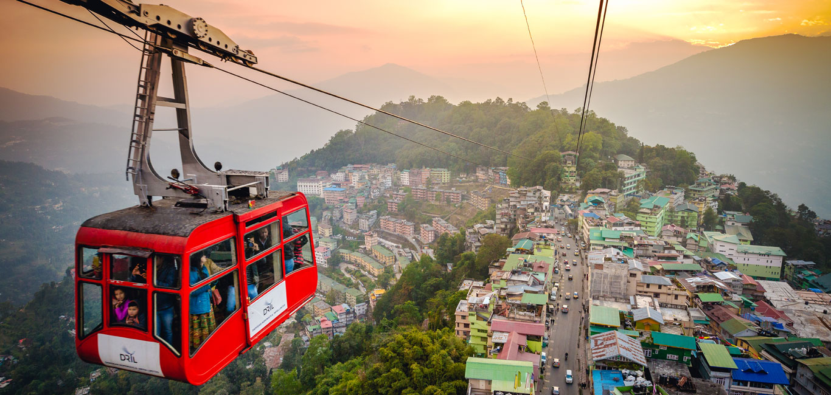
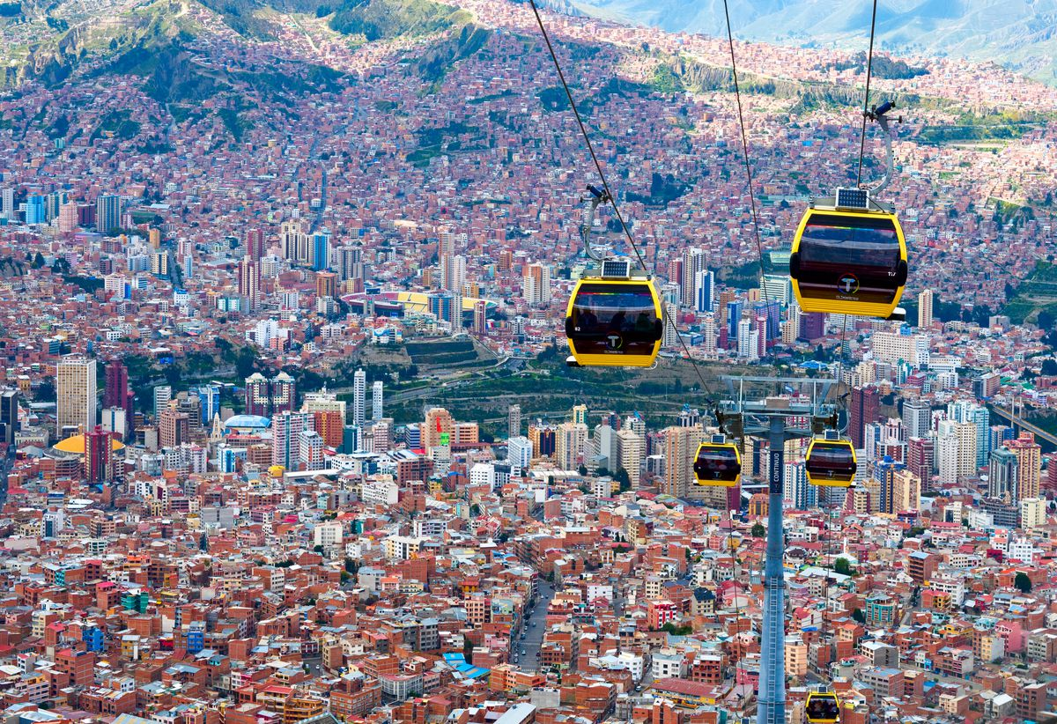
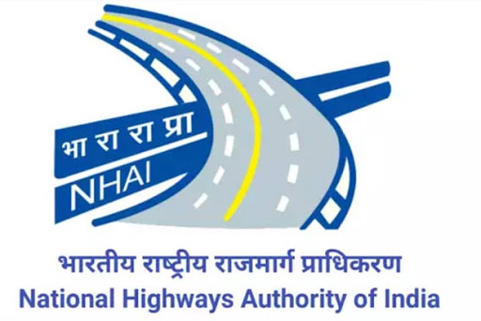

National Ropeways Development Programme – Parvatmala Pariyojana

Slide 2
Introduction
Ministry of Road Transport & Highways (MoRTH) vide letter dated 05.08.2021 allocated the work related to Ropeways and other innovative/alternative mobility solutions to National Highways Logistics Management Limited (NHLML), 100% owned SPV of NHAI.
In the Union Budget 2022-23, National Ropeways Development Programme – “Parvatmala Pariyojana” was announced as ecologically sustainable alternative to conventional roads in difficult hilly areas with the aim to improve connectivity and convenience for commuters, besides promoting tourism.
Secretary, MoRTH vide DO letter dated 23.02.2022 requested Chief Secretaries of all States and Union Territories to identify and provide the list of ropeway projects to be taken up under Parvatmala Pariyoana.
MoRTH vide letter no. NHLML/Ropeways/SoP/2021 dated 07.03.2022 issued SOP to the State Govt. for submission of proposals to the Ministry/ NHLML for development of Ropeway/ Alternate/ Innovative Mobility Projects in the State.

Slide 3
Standard Operating Procedure (1/2)
State Governments may undertake the development of the proposed projects independently on their own. MoRTH/ or NHLML may facilitate and provide necessary support, as required by the State Government, for the implementation of the project. The State Government shall be entirely responsible for the complete implementation and execution of the project.
State Governments willing to partner with MoRTH through NHLML, under the Parvatmala Pariyojana, shall have the option to execute the project through multiple models of implementation, as under:
Through SPV between NHLML and State Government (at least 26% equity contribution by State Government)
State-specific SPV(s) shall be formed between NHLML and the State Government for implementation of ropeway projects.
NHLML shall be the lead stakeholder by arranging funds for development of the proposed project, whereas State Government shall contribute to at least 26% equity in the SPV.
The land for development of stations and towers of ropeways and land for associated commercial development shall be provided by State Government at their own cost.
Utility Shifting shall be done by State Government at their own cost.
NHLML shall be responsible for project prioritization, appraisal and implementation of the concerned project, including award of concession to private party and / or implement the project based on most optimal mode of implementation.

Slide 4
Standard Operating Procedure (2/2)
Partnership between State Government and NHLML through independent execution by NHLML (support from State Government formalized through a State Support Agreement)
State Governments can partner with NHLML by authorizing NHLML to execute the proposed project independently.
State Government shall formalize their support through a State Support Agreement with NHLML.
NHLML shall be responsible for the complete implementation / execution of the proposed project.
The land for development of stations and towers of ropeways and land for associated commercial development shall be provided by State Government at their own cost.
Utility Shifting shall be done by State Government at their own cost.

Slide 5
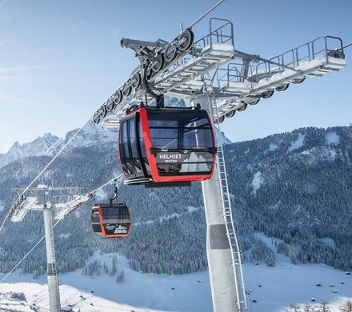
Types of Ropeway Systems
Monocable Detachable Gondola (MGD)
Bi-Cable Detachable Gondola (2S)
Tri-Cable Detachable Gondola (3S)
Funitel (FUNI)
Aerial Tram / Jig Back Ropeway
Monocable Detachable Gondola (MGD)
Single cable car with detachable grip system in which the cable car cabin is attached & detached to a moving drive cable.
One of the most successful ropeway systems in the world.
Drive cable itself provides both the guide for the cable car cabins and the haul cable.
Safe, comfortable and efficient form of transport.

Slide 6
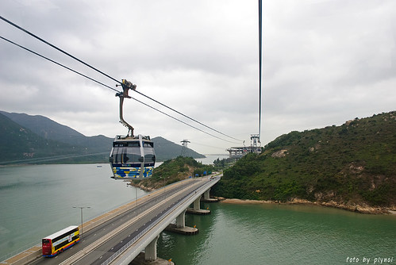
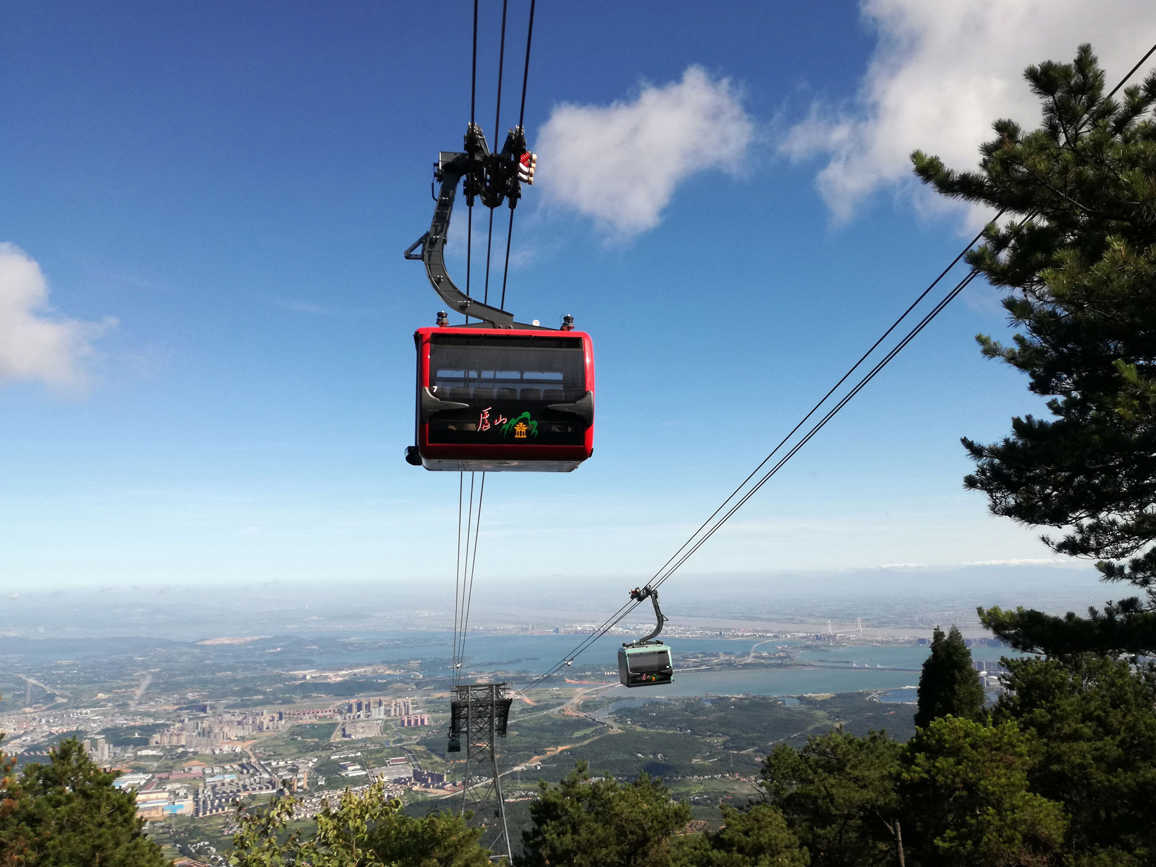
Tri-Cable Detachable Gondola (3S)
Bi-Cable Detachable Gondola (2S)
2S system combine the use of gondola and reversable rope system. There are separate ropes that provide the track and haul cable.
Allows longer spans to be achieved between supports.
Provides improved and higher capacity and efficient operation at the terminals.
Static cables provide the support ropes or track cables and a third cable provides the drive or haul cable from the cable car cabins detach themselves at embarkation stations.
Has two stationary track cables.
More expensive to develop, deploy and operate than MGD and 2S system.
Has higher passenger capacity and operate at higher speed.
Improved stability in high wind conditions.
Ability to utilize longer spans and lower energy consumption.

Slide 7
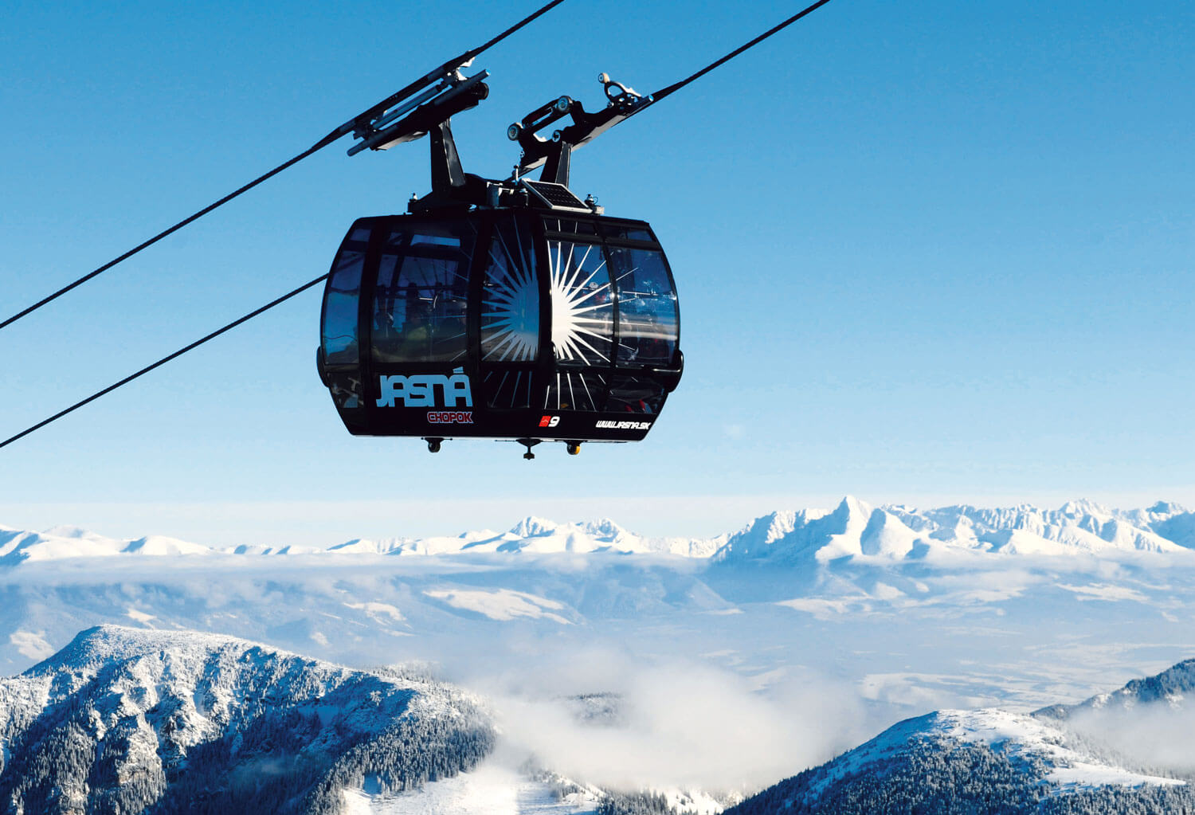
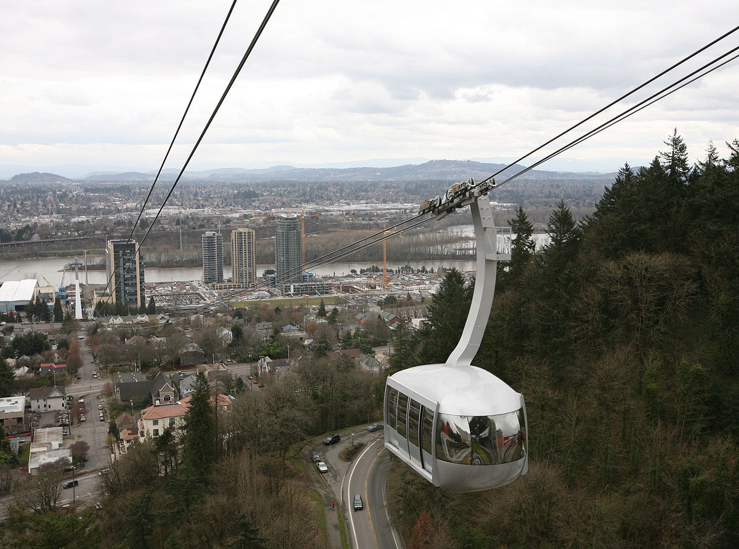
Funitel cable car system (FUNI)
Consists of one or two loops of cable which span between two terminals and are supported over intermediate towers.
To provide stability to cabins, cables are arranged in two pairs moving in separate directions.
Generally used to transport skiers.
Provides fast and efficient way to get to transport people to a higher altitude.
It differs from a standard gondola lift through the use of two arms attached to two parallel overhead cables.
Aerial Tram / Zig Back ropeway
Two cabins are attached and suspended from one or more fixed cables form the track and the cable car is pulled by haul cable.
The system pulls one car down the line and uses the weight of the car moving downhill to pull the reciprocal car uphill.

Slide 8
Comparison of Ropeway systems
Aerial Ropeway System | Max Capacity (PPHD) | Cabin Capacity (Persons) | Max Tower Spacing (m) | Land Use | Relative Capital Costs
Monocable Detachable Gondola (MGD) | 4,500 | 10 | 400 | Low | Low
Bi-cable Detachable Gondola (2S) | 5,000 | 15 | 700 | Medium | High
Tri-cable Detachable Gondola (3S) | 6,000 | 36 | 2,500 | High | High
Funitel | 5,000 | 24 | 800 | High | High
Aerial Tram / Zig Back ropeway | 1,500 | 200 | 2,500 | High | High

Slide 9
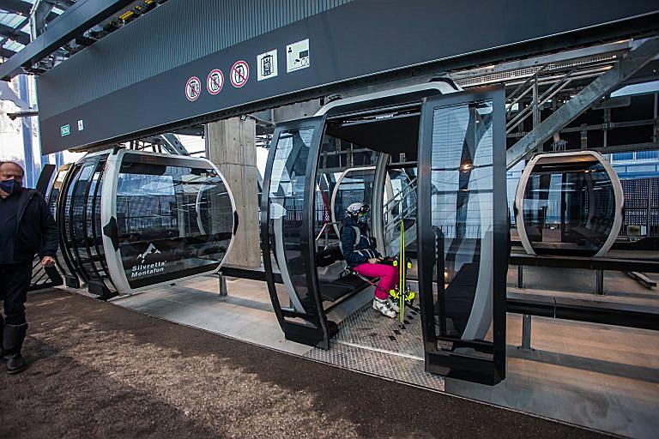
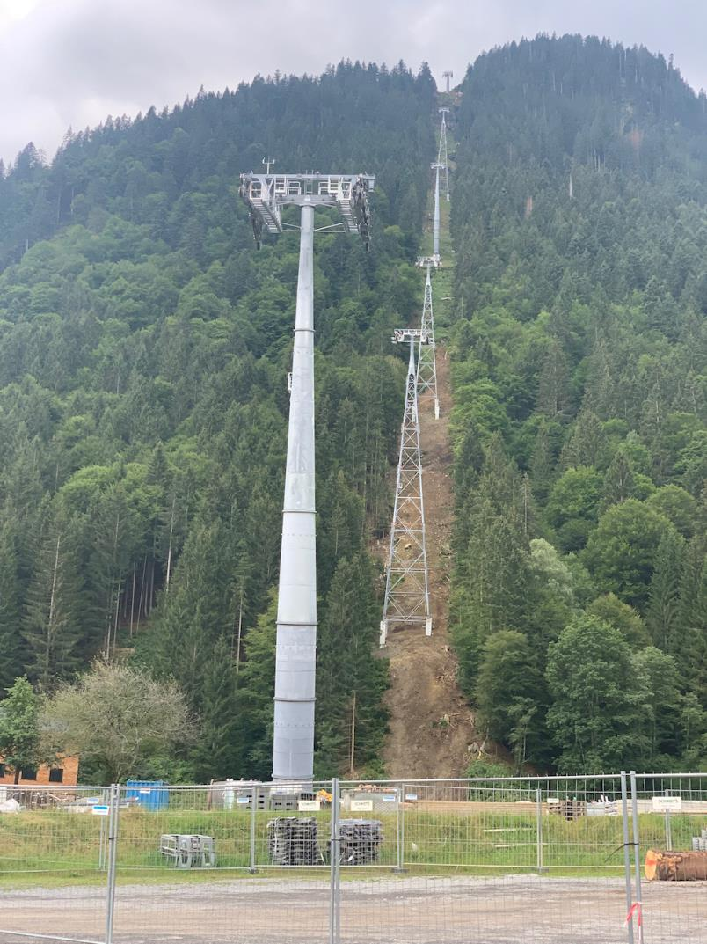
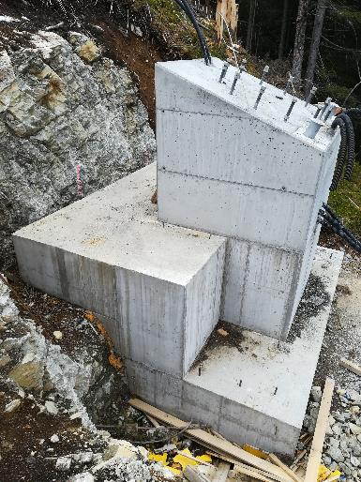
Example for Type of Cabin
  10 Seater Cabin
  Level Walk In
  Automatic doorsystem
  Detachable grip-system
  Ventilation via windows
Example for Type of Tubular Tower
Foundation

Slide 10
Ropeway Projects being taken up in North India (1/3)
NHLML has invited the bids for following ropeway projects in North India:
S. No. | Name of the Project | State | Length (in Km) | Estimated Project Cost (in Rs. Crores) | PPHPD | Technology | Completion Period (in Years) | Status
1 | GauriKund - Kedarnath | Uttarakhand | 9.70 | 1047.71 | 3600 | Tri-cable Detachable Gondola (3S) | 4 | Bids ReceivedTo be Awarded
2 | Govind Ghat - Ghangaria - Hemkund Sahib | Uttarakhand | 12.40 | 976.82 | 2200 | Govind Ghat - Ghangaria - MDG Ghangaria - Hemkund Sahib - 3S | 4
3 | Nature's Park (Mohal) to Bijli Mahadev Temple, Kullu | Himachal Pradesh | 2.334 | 186.97 | 1800 | MDG | 2 | Bidding under Process
4 | Ransoo Bus Stand to Shivkhori Cave | Jammu and Kashmir | 2.116 | 169.90 | 1800 | MDG | 2
NHLML has initiated Detailed Feasibility Study for following ropeway projects in North India:
S. No. | Name of the Project | State | Tentative Length (in Km)
1 | Shankaracharya Temple, Srinagar | Jammu and Kashmir | 1.00
2 | Leh Palace to Shanti Stupa | Ladakh | 2.010

Slide 11
Ropeway Projects being taken up in North India (2/3)
NHLML is initiating Detailed Feasibility Study for following ropeway projects in North India:
S. No. | Name of the Projects | State | Tentative Length (in Km)
1 | Baltal - Amarnath Cave | Jammu and Kashmir | 9.00
2 | Nasri Tunnel to Sanasar Ropeway | Jammu and Kashmir | 3.00
3 | Bhaderwah to Seojhdar | Jammu and Kashmir | 7.00
4 | Golden Temple, Amritsar | Punjab | 3.00
5 | Rishikesh (Barrage) to Neelkanth, Rishikesh | Uttarakhand | 5.00
6 | Raithal/Barsu to Barnala, Uttarkashi Distt. | Uttarakhand | 4.00
7 | Shirgul Mahadev Temple | Himachal Pradesh | 3.50
8 | Kankachori to Kartik Swami Dharmshala, Rudraprayag Distt. | Uttarakhand | 1.50
9 | Ranibagh to Hanuman temple, Nainital | Uttarakhand | 11.50
10 | Joshimath Auli Garson | Uttarakhand | 7.00
11 | Kuteti devi temple-Vishwanath temple, Varunavat Top, Uttarkashi Distt. | Uttarakhand | 2.00
12 | Kargil | Ladakh | 0.250

Slide 12
Ropeway Projects being taken up in North India (3/3)
The Projects shall be developed primarily on Hybrid Annuity Mode.
The capacity of the system and type of technology for each project shall be decided based on the traffic & demand assessment, type of terrain and requirement of the project.

Slide 13
THANK YOU

